Slide 1
TRoQ – Carpentry
ITP Carpentry Tutor conference December 2014

Slide 2
Background to TRoQ
‘too many quals’ (NZQA): Constr: 132 to 34
More alignment
Industry needs (Macro & micro)
Pathways for learners
More extensive consultation, stakeholder involvement
Carpentry/Construction started mid 2012, led by BCITO
ITP reps on working groups for L3 & 4 quals

Slide 3
phase two – development
NZQA gave approval to (re) develop
NZ Cert in Carp Level 4
Working group developed revised L4 qual:
No unit standards, now 6 Specifications
No elective components
Focus on skills, knowledge & capability
Overview
Preliminaries specification

Slide 4
So what now/next?
Final draft approved by NAG
Now with NZQA , seeking ‘approval to list’
Programme approval follows
Collaboration for development of programme/s
Timing?
Listed with NZQA early 2015
Develop programme throughout 2015
1st delivery from 2016?
1st graduates sometime on 2019?

Slide 5
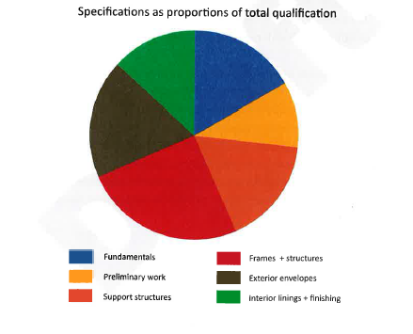
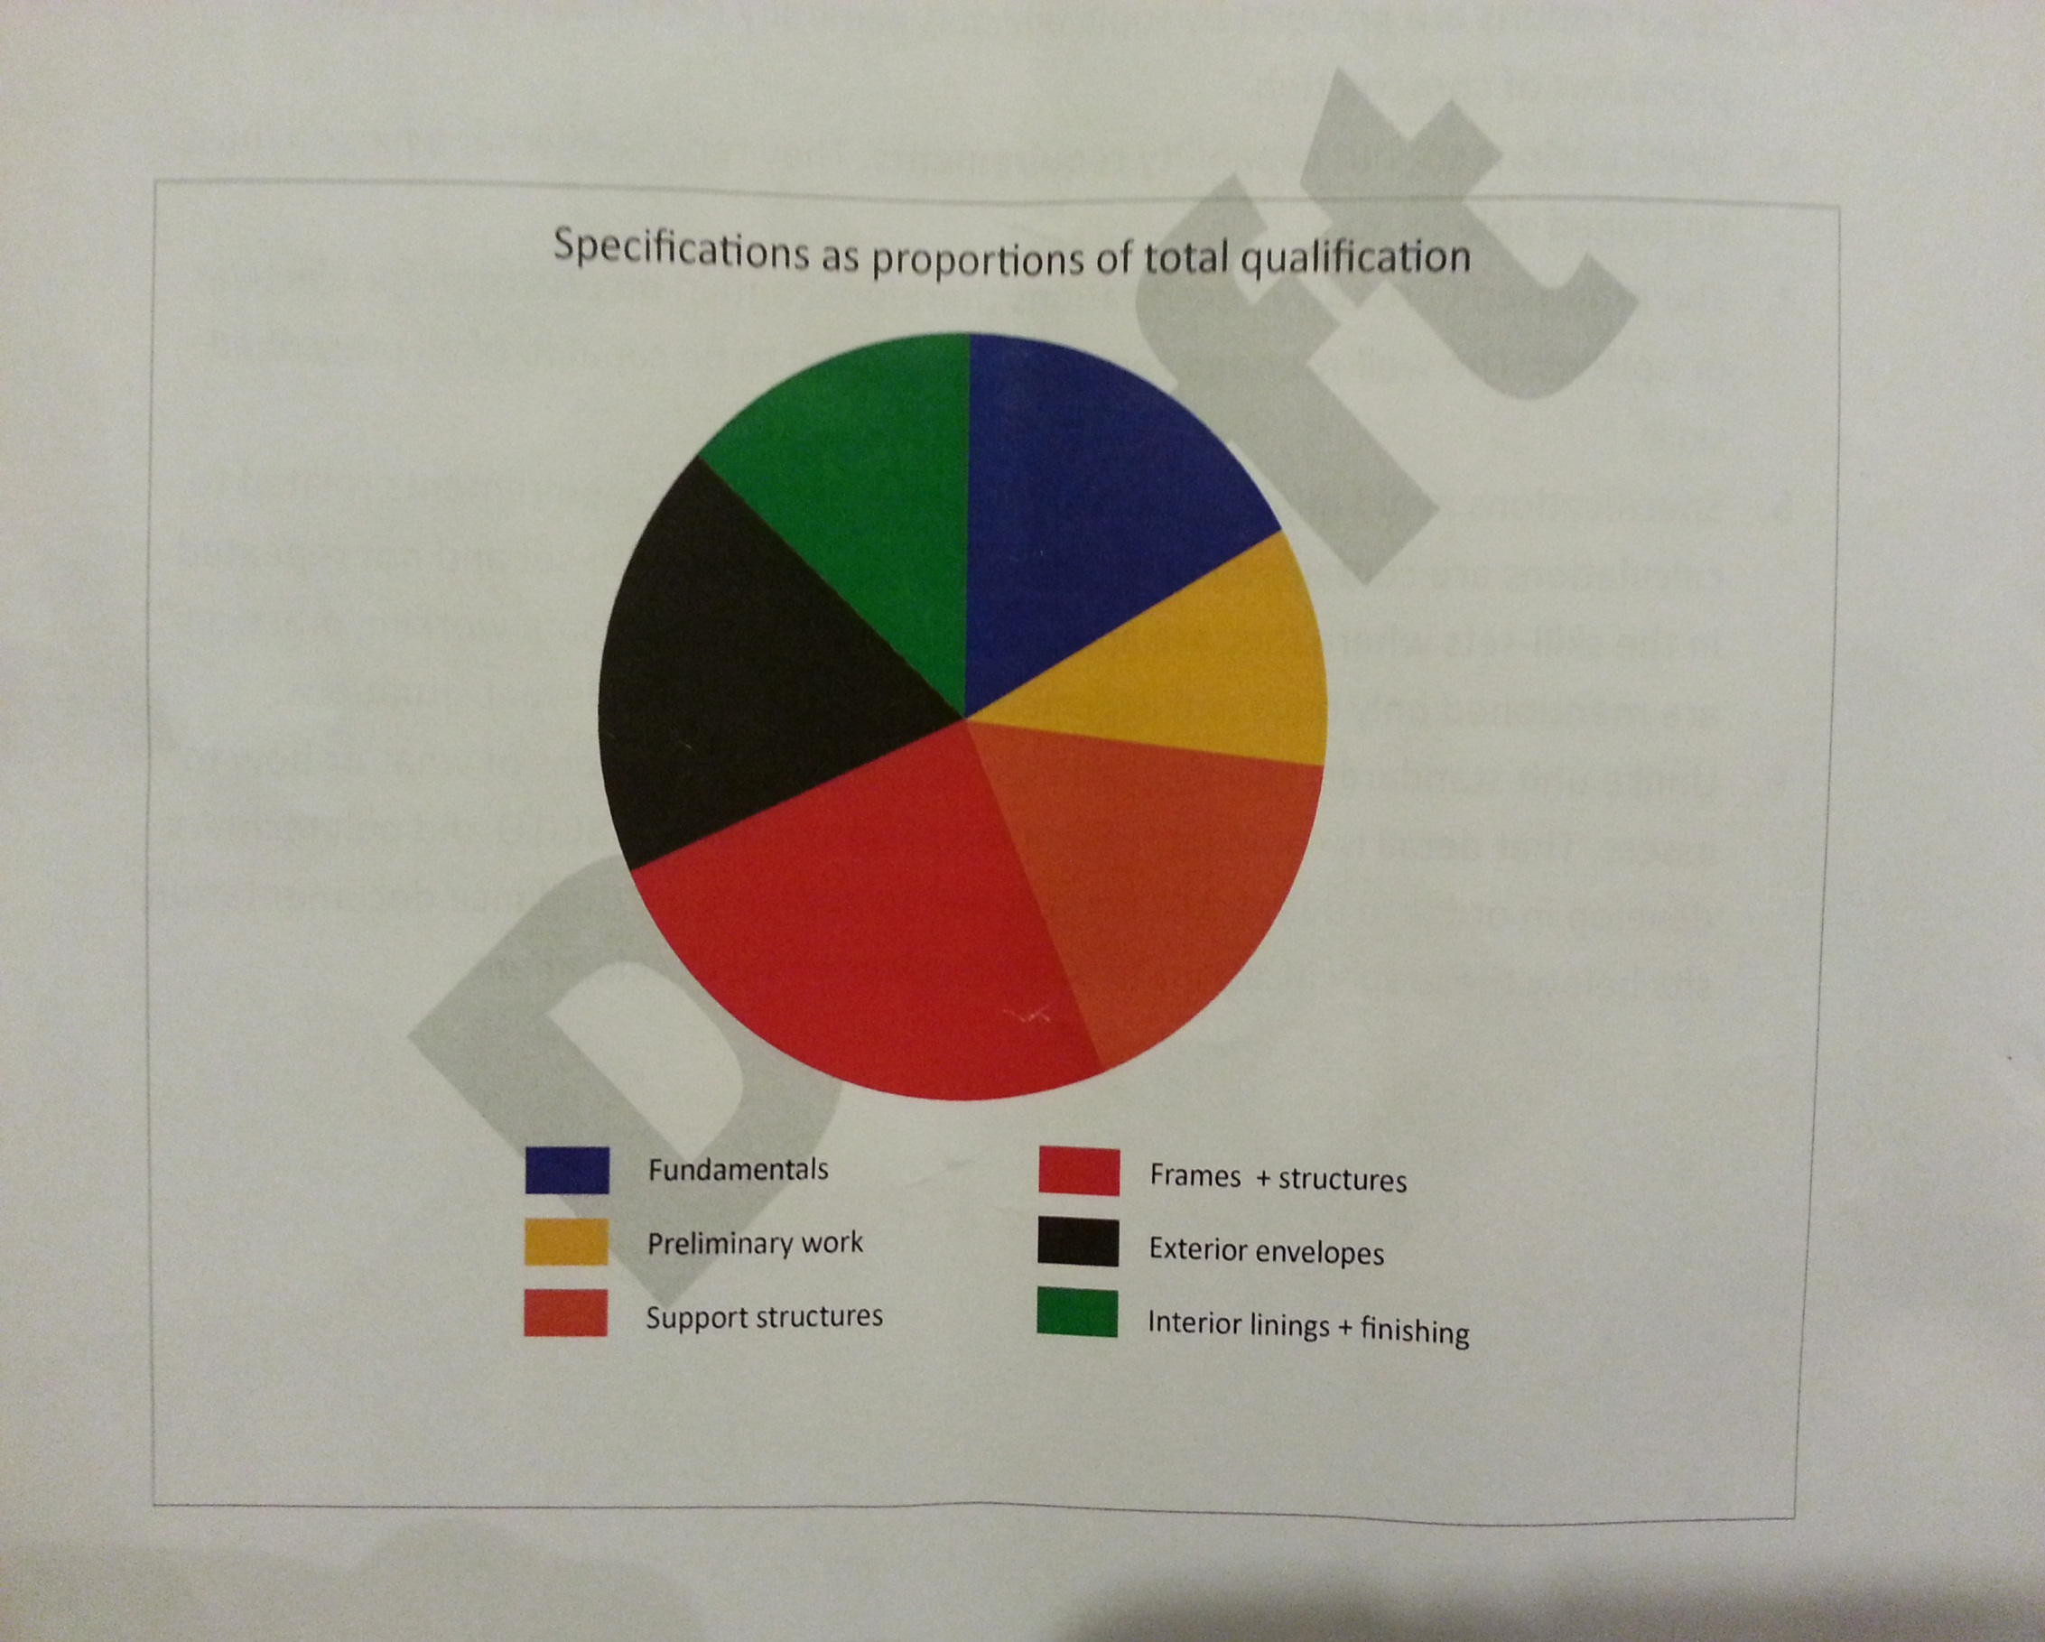

Slide 6
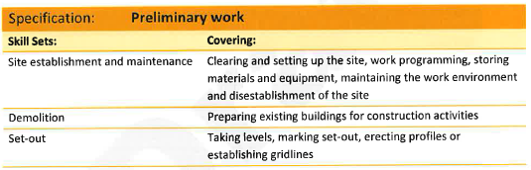
Extract from PRELIMINARIES
Specification – Skill Sets
‘unit’
‘range’

Slide 7
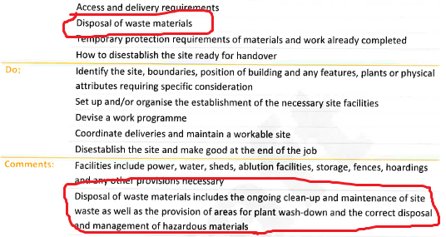
‘Know’
(be able to) do
Context

Slide 8
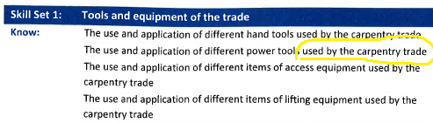
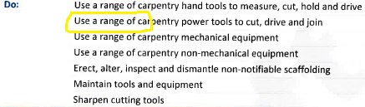
Extract from FUNDAMENTALS Specification –
Skill Set 1: Tools & equipment
‘Know’
(be able to) do

Slide 9
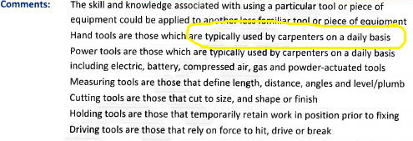
Extract from FUNDAMENTALS Specification –
Skill Set 1: Tools & equipment
Context

Slide 10
Summary/future focus
No real change to graduate profile
Qual is now 300Cr, up from 294 (min)
Thinking, planning, action needed on
Programme/curriculum – integrated, seamless
Delivery - models, resources
Assessment – measuring capability
Moderation – consistency across ITPs, industry

Slide 11
This qualification is for those new to or wishing to enter the construction industry.
The qualification is designed to provide the wider construction industry with work-ready people who have developed essential transferable skills and underpinning knowledge applicable in a wide range of construction related trades.
Graduates will have the ability to enter work in their chosen field or undertake an apprenticeship. They will be able to work at entry level and under limited supervision.

Slide 12
Graduates of this qualification will be able to:
Understand compliance with regulatory requirements
for construction related trades (10 credits)
Work safely according to Health and Safety guidelines (10 credits)
Communicate effectively with colleagues and other tradespeople (10 credits)

Slide 13
Construction Industry (30 credits)
Understand and use construction industry terminology and materials, and construction, installation and application processes (10 credits)
Carry out assigned work tasks (20 credits)

Slide 14
Carpentry (90 credits)
Understand and use specific carpentry terminology and materials, and construction, installation and application processes (30 credits)
Carry out assigned carpentry work tasks in a project environment (60 credits)

